Slide 1

US Cost of Living Dataset Analysis
Coding Temple
Self-Paced Data Analysis
Capstone II Project

Slide 2
TABLE OF CONTENTS
01
02
03
04
CAPSTONE II PROJECT OVERVIEW
DATASET ANALYSIS
HYPOTHESES AND CONCLUSIONS
APPENDIX – RSTUDIO, PYTHON, TABLEAU

Slide 3

01
CAPSTONE II PROJECT OVERVIEW

Slide 4
CAPSTONE II PROJECT OVERVIEW
Assignment
For this project, rather than writing a report, you will analyze a new data set (not the same as Capstone I) of your choice from Kaggle, then present your analysis via a pre-recorded Loom video. You will need a webcam for this assignment.
Similar to the previous capstone, you will be analyzing data and presenting, just in a different format, and with a new data set.
Pre-recorded video. Using Loom or similar, you will be showing your screen and your analysis - your graphs, charts, results, and explanations of the data - while your video is somewhere on the screen. Part of this job is presenting information to other people.
Present your findings, hypotheses, analysis, graphs, charts, methodologies, and anything else relevant in video format. When submitted please schedule a time to present here: https://scheduler.zoom.us/d/tgmpvv4s/data-capstone.

Slide 5
CAPSTONE II PROJECT OVERVIEW
Dataset Selected
Source: Kaggle
Dataset: US Cost of Living Dataset (1877 Counties)
Dataset Overview
Modest yet adequate family budget estimates for 1877 US counties.
The US Family Budget Dataset provides insights into the cost of living in different US counties based on the Family Budget Calculator by the Economic Policy Institute (EPI).
This dataset offers community-specific estimates for ten family types, including one or two adults with zero to four children, in all 1877 counties and metro areas across the United States.
Data Analyzed
US State
Average Annual Household Income
Average Annual Household Expense
Housing, Food, Transportation, Healthcare, Childcare, Taxes, and Other Necessities
Average Annual Household Profit or Loss

Slide 6

02
DATASET ANALYSIS

Slide 7
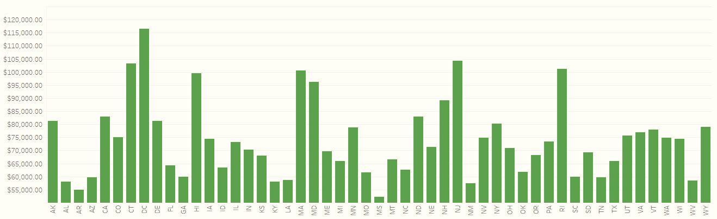
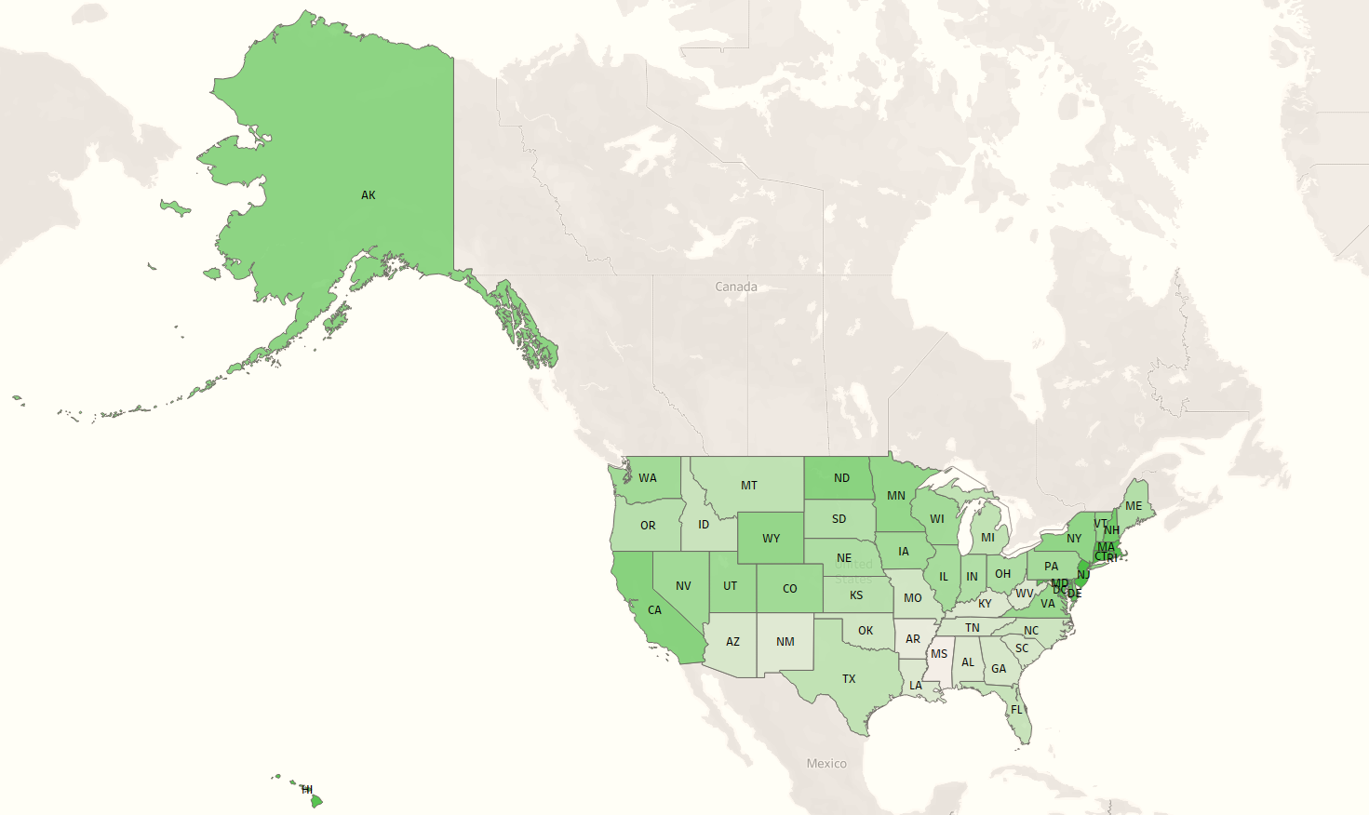

DATA ANALYSIS
Average Annual Household Income
State | Income
Five Highest
Washington, D.C. | $116,607
New Jersey | $104,246
Connecticut | $103,228
Rhode Island | $101,153
Massachusetts | $100,532
Five Lowest
Mississippi | $52,282
Arkansas | $55,026
New Mexico | $57,366
Alabama | $58,100
Kentucky | $58,144

Slide 8
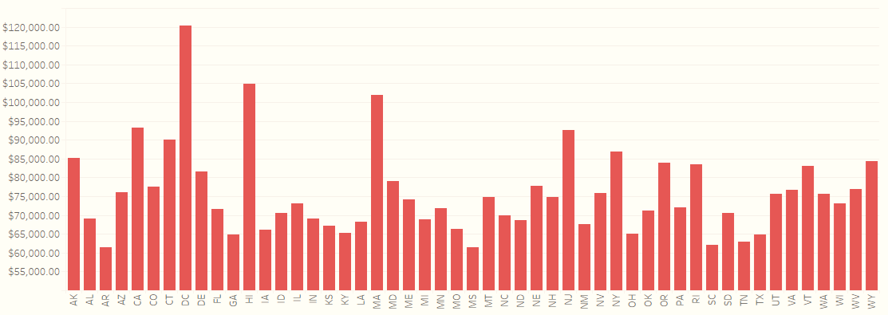
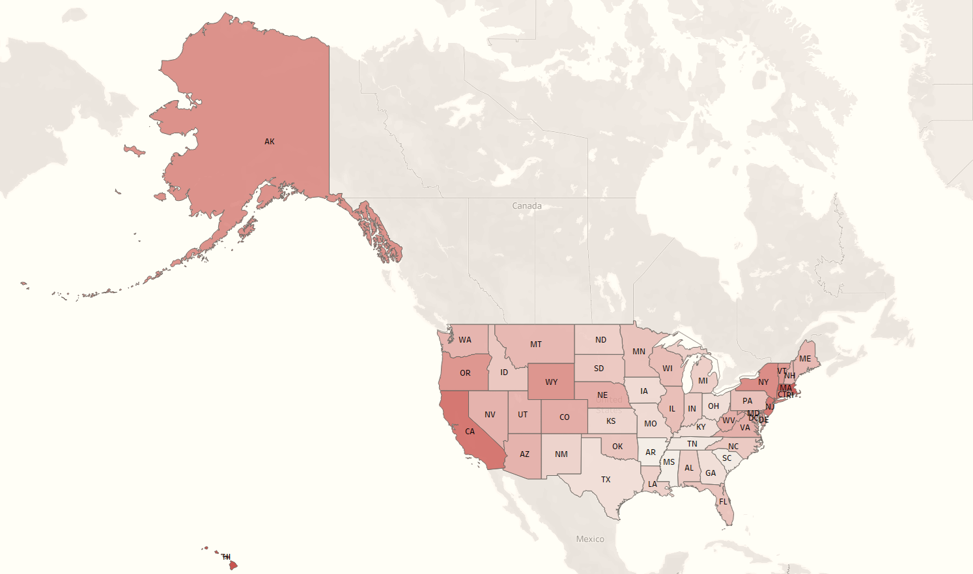

DATA ANALYSIS
Average Annual Household Expense
State | Cost
Five Highest
Washington, D.C. | $120,290
Hawaii | $104,897
Massachusetts | $101,892
California | $93,179
New Jersey | $92,575
Five Lowest
Mississippi | $61,361
Arkansas | $61,492
South Carolina | $62,105
Tennessee | $62,871
Texas | $64,795

Slide 9
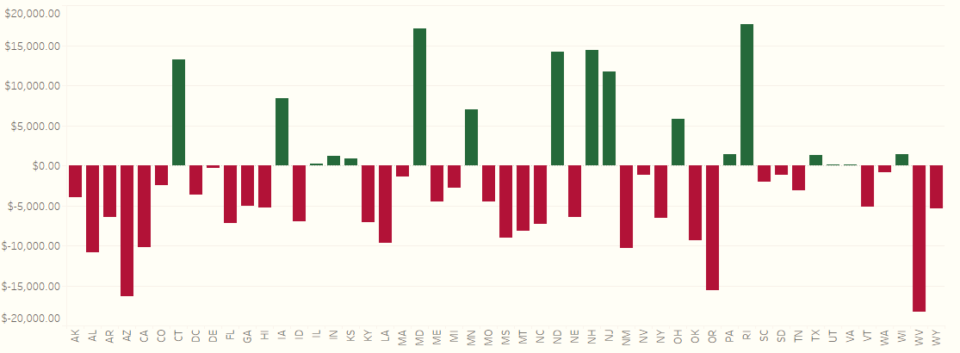
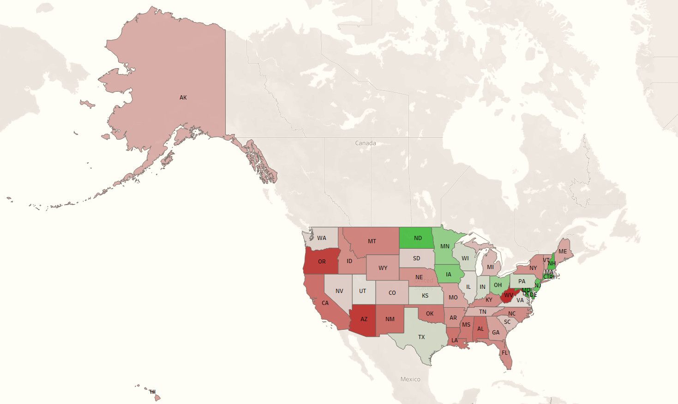

DATA ANALYSIS
Average Annual Household Profit or Loss
State | Profit/Loss
Five Highest
Rhode Island | $17,640
Maryland | $17,137
New Hampshire | $14,397
North Dakota | $14,171
Connecticut | $13,215
Five Lowest
West Virginia | -$18,303
Arizona | -$16,324
Oregon | -$15,585
Alabama | -$10,868
New Mexico | -$10,322

Slide 10
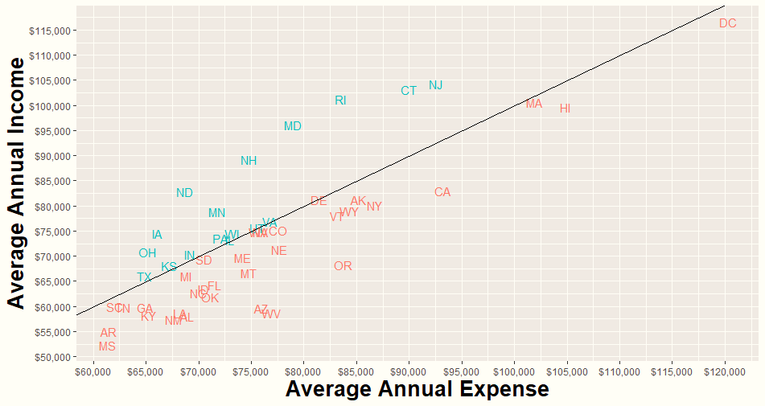
DATA ANALYSIS
Average Annual Household Income/Expense

Slide 11
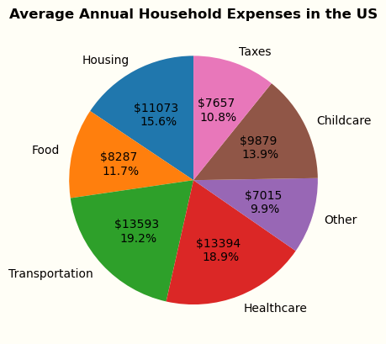
DATA ANALYSIS
Average Annual Household Expenses
Household Expense |  | State | Amount
Childcare | Highest | Washington, D.C. | $31,940.49
 | Lowest | Mississippi | $3,847.00
Food | Highest | Hawaii | $12,852.93
 | Lowest | Kentucky | $7,454.15
Healthcare | Highest | West Virginia | $20,142.65
 | Lowest | Maryland | $9,015.97
Housing | Highest | Hawaii | $22,335.14
 | Lowest | Arkansas | $8,886.49
Other | Highest | Hawaii | $12,750.02
 | Lowest | Arkansas | $6,042.00
Taxes | Highest | Washington, D.C. | $21,744.79
 | Lowest | Tennessee | $4,342.95
Transportation | Highest | Utah | $14,934.51
 | Lowest | Washington, D.C. | $7,961.97

Slide 12
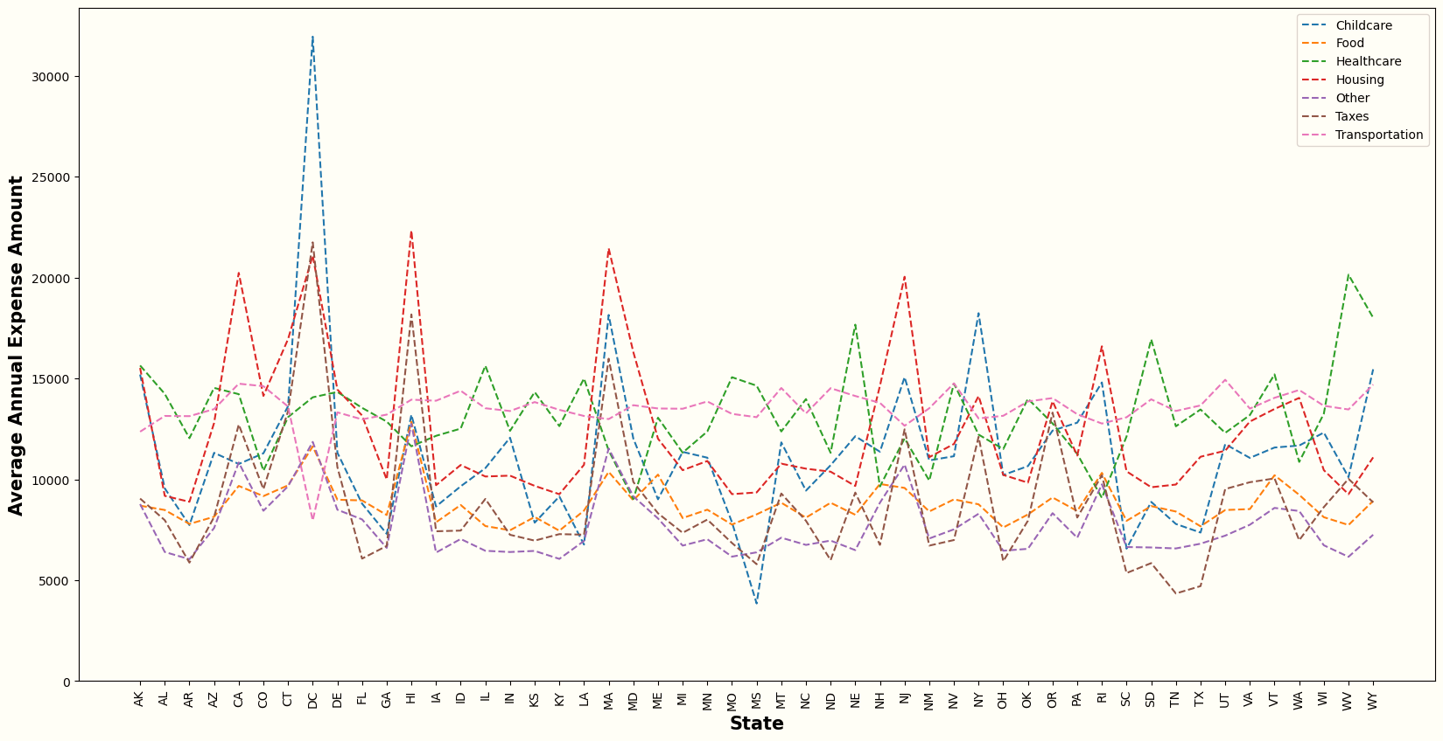
DATA ANALYSIS
Average Annual Household Expense Amounts by Type and State

Slide 13

03
HYPOTHESES AND CONCLUSIONS

Slide 14
HYPOTHESES AND CONCLUSIONS
Hypotheses
1. The West and Northeast regions will have the highest annual household income and expense averages.
Income Finding: Correct. The Northeast is highest at $83,909 and the West is second at $74,132.
Expense Finding: Correct. The Northeast is highest at $81,800 and the West is second at $80,113.
2. California and New York will have the highest annual state household income and expense averages.
Income Finding: Incorrect. Washington D.C. is highest at $116,607; California is 9th and New York is 13th.
Expense Finding: Incorrect. Washington D.C. is highest at $120,290; California is 4th and New York is 7th.
3. The Midwest region will have the highest annual profit average.
Finding: Incorrect. The Northeast is highest at $2,110; the Midwest is second highest at $1,509.
4. The Southeast region will have the lowest annual profit average.
Finding: Correct. The Southeast is the lowest at -$6,437.
5. Hawaii will have the highest annual state housing expense average.
Finding: Correct. Hawaii was the highest at $22,335 spent annually, with Massachusetts second at $21,448.
6. Housing will be the highest average annual household expense across the US.
Finding: Incorrect. Housing is the 3rd highest behind transportation and healthcare.
7. Housing will have the highest state-to-state average annual expense variance.
Finding: Incorrect. Childcare has the highest variance at $28,093.49; housing is 3rd highest with taxes at 2nd.
Important Note: The dataset is based on a sample of counties from each state used to determine an average for the state. Results would very likely differ with all counties included.

Slide 15
HYPOTHESES AND CONCLUSIONS
Conclusions
The highest average annual household income is found in the Northeast. The top five states are all located in this region: Washington D.C., New Jersey, Connecticut, Rhode Island, and Massachusetts.
The highest average annual household expense is found in the Northeast and West. The top five states are: Washington D.C., Hawaii, Massachusetts, California, and New Jersey.
The highest average annual household profit is found in the middle Northeast and upper Midwest. The top five states are: Rhode Island, Maryland, New Hampshire, North Dakota, and Connecticut. These states are followed by New Jersey, Iowa, Minnesota Ohio, and Pennsylvania, all also found in the middle Northeast to upper Midwest.
The lowest average annual household profit is found in the Southeast. Seven of the lowest thirteen states are found in this region: West Virginia, Alabama, Louisiana, Mississippi, North Carolina, Florida, and Kentucky.
Determining the best place to live financially depends on many factors. For example:
If you are on a fixed income or able to work remote, focus on less expensive states to maximize income.
If a certain expense(s) doesn’t apply, look at areas with higher income without factoring in that expense.
Example: Washington D.C. is the #1 state in highest average annual household income and expense. However, if childcare doesn’t apply to you, Washington D.C. drops down to #6 highest average annual household expense while remaining #1 in income.
It’s also important to keep in mind other demographic factors that may impact the numbers. For example, Arizona, California, New Mexico, and Florida are all in the bottom twelve states for lowest average annual household profit, however, are popular retirement locations which could pull down the average income numbers.
Important Note: The dataset is based on a sample of counties from each state used to determine an average for the state. Results would very likely differ with all counties included.

Slide 16

04
APPENDIX - RSTUDIO, PYTHON, TABLEAU

Slide 17
APPENDIX – RSTUDIO, PYTHON, TABLEAU
RStudio Code
Python Code
Tableau

